Slide 1
Sensor Fusion-based Emotion Classification In Virtual Reality Using Machine Learning
@期末発表
M1 劉浥(21860638)
情報科学域
指導教員 山口亨
Notes:
Hello,everyone.
Today,My presentation title is <Sensor Fusion-based Emotion Classifcation In Virtual Reality Using Machine Learning>.

Slide 2




Intorduction
The development of virtual reality technology has made VR content available to the average household
—————————————————————————————————
Emotions are sometimes not expressed
And information expressed,
such as facial expressions and voices,
can differ from the actual emotion[1]
————————————————————————————
To recognize true individual emotion・group dialogue atmosphere
using biometric information in VR
Notes:
In recent years,
The development of virtual reality technology has made VR content available to the average household
For affective computing,
Researchers find
Emotions are sometimes not expressed And information expressed, such as facial expressions and voices,
can differ from the actual emotion
based on this understanding，i want to recognize true individual emotion and group dialogue atmosphere
using biometric information in VR environment

Slide 3


Related Work
Automatic Emotion Recognition
→biological information,
→External features
→environement, etc.
In Yuhei Ikeda's research
→Brain waves and heart rate were uesd for Estimating Emotion for Robot Interaction[1]
In Marín-Morales's research
→They researched emotion recognition from brain and heartbeat dynamics using wearable sensors
in virtual reality[3].
In NS Suhaimi’s research
→They did Emotion state classification of EEG brain signal using SVM and KNN[4]
Mood Enginnering[5]
→”Atmosphere”
→proposed by the Japanese Society for Artificial
Intelligence(JSAI) in 2013.
DNP——"next-generation stealth space"
→Change the color of light and music in a room by using sensors to detect the status of people’s presence and conversations and the indoor environment.
In Shohei Kato's research
→They researched Dialogue Mood Estimation
Focusing on Intervals of Utterance State[6]
→Use Speech Sounds considering Personality Trait of Speaker for Dialogue Mood Estimation[7]
Notes:
Related Work
For Automatic Emotion Recognition
we usually use biological information
human External features and sometiems environement data
a lot of researches had been conducted in Human robot interaction
..and the AEE researches in VR are also popular.
In Marín-Morales's research, they use brain and heartbeat dynamics for emotion recognition in VR
In NS Suhaimi’s research,They did Emotion state classification of EEG brain signal using SVM and KNN
Mood Enginnering,which is proposed by JSAI, is a thoery to study “atmosphere”
DNP had developed a smart room that can change light and music according to the indoor atmosphere
In Shohei Kato's research
they use utterance features to estimate dialogue atmosphere

Slide 4
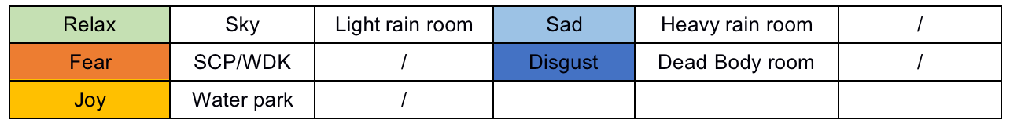
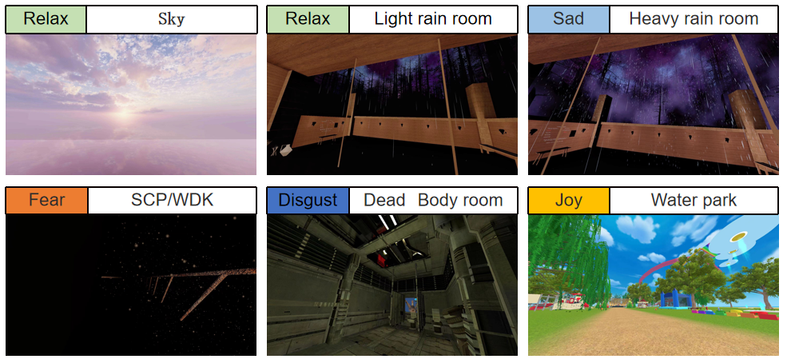

Preliminary Experiment
APP：VRChat
Participants:10 participants aged between 20 through 28
Used Features：EEG,Accelerator(Muse2 headband), HRV<-ECG(Polar H10)
Worlds:Six worlds for arousing different emotions in VRchat with Reference to
AVRS. Each world for about 3 minutes. We used last minute's data.
Notes:
My first experiment,
was conducted in VRChat
10 participants were recruited to experience Six virtual worlds in VRCHat
The EEG and ECG will be recorded, we use EEG,accelerator and HRV extracted from ECG as features.
and every section will last for about 3 minutes.We use the data of last minute.

Slide 5
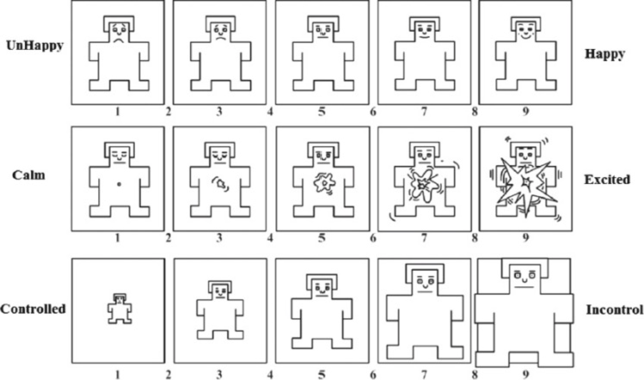
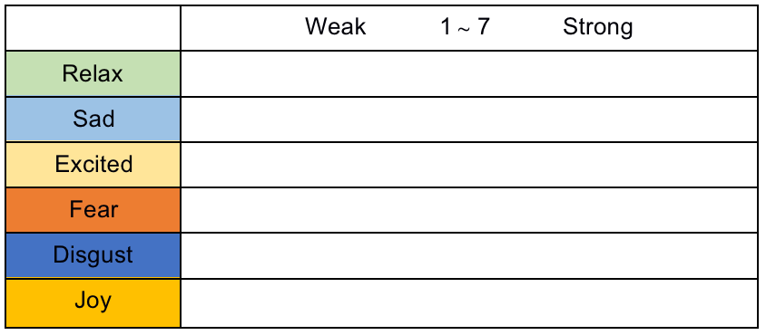
Preliminary Experiment
Questionnaire:SAM questionnaire[8], Six emotions questionnaire
Valence
Confirm the effectiveness of VRChat worlds to arouse emotion
Better understand participants' mood state
Help participants better self-report
Arousal
Dominance
Basic Emotion
Level
Notes:
After each section, they need to answer SAM questionnaire and six emotions questionnaire
SAM questionnaire can be used to self-report participants' Valence,Arousal and Dominance level,
and Six emotions quesitonnaire is used to evaluate participants' basic emotion level
By these two questionnaire，we can
（1）Confirm the effectiveness of VRChat worlds to arouse emotion、
（2）Better understand participants' mood state during the experiment
（3）Help participants better self-report their emotions

Slide 6
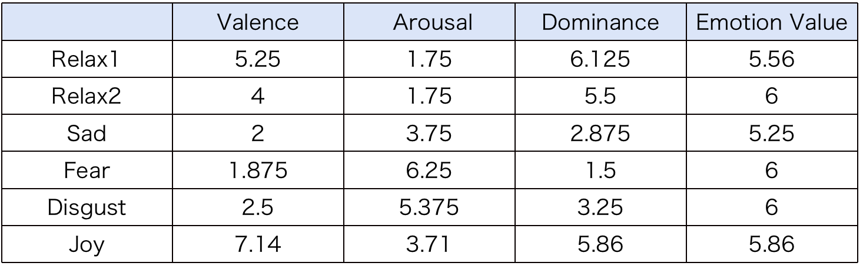
Preliminary Experiment
Self-report Result（Average）：
The emotional arousal experiment in VRChat can effectively arouse collaborators’ emotions.
There are situations where collaborators are happy&relaxed(Fear&Disgust, Excited&Joy) simultaneously
->Those emotions are not discrete in some cases.
Notes:
Accoding to the self-report result ,the emotional arousal experiment in VRChat can effectively arouse collaborators emotions.
We also found there are situations where collaborators are happy&relaxed(Fear&Disgust, Excited&Joy) at the same time.
It suggests that those emotions are not discrete in some cases.

Slide 7
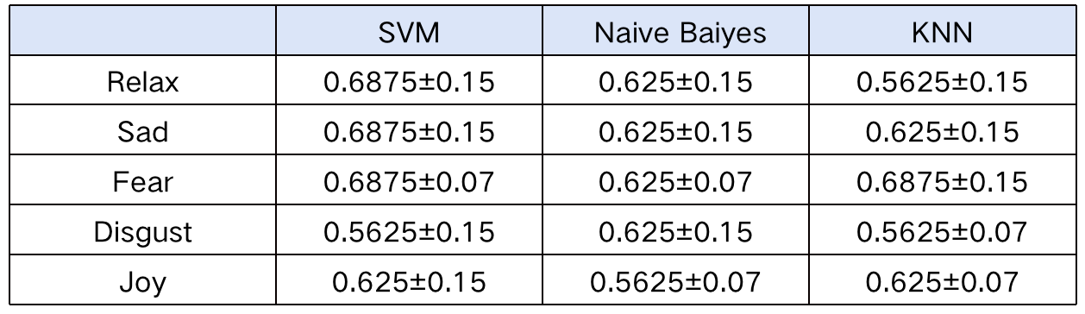
Preliminary Experiment
Cross-Validation Classification Result：
After normalization, PCA, one-hot encoding,
we trained SVM, Naive Bayes and KNN for emotion classification
Limitation:
Poor contact problem of Muse2 Headband
Individual differences appear(not typical data)
Small amount of training data
Notes:
We trained SVM,Naive Bayes and KNN to classify emotion
Accoding to the result ,we know EEG and ECG can be used to classify emotion in VR
However, because of the poor contact problem of Muse2 brainwave headband, the EEG data collected are not very good
and we find individual differences appear in our experiment
what’s more ,the amount of training data is too small,we need to collect more data

Slide 8

Second Experiment
APP：Horizon Workrooms
Participants:
Six pairs of collaborators were recruited
Used Features：
HRV<-ECG(Polar H10),
audio features[9]<-noise-reduced WAV
<-MP3(Sony Recorder)
Details:
Two collaborators were sitting in separate quiet classrooms
they can not hear each other if they do not wear VR headset
Each conversation lasted approximately three minutes
Take a break betwenn each topic and answer the questionnaire
Topic:
be chosen randomly,
likely to cause emotional fluctuations or produce opposing positions
Notes:
The second Experiment were conducted in Horizon Workrooms
SIx pairs of collaborators were recruited to talk in the virtual meeting room
We had abandoned Muse2, and only use ECG and audio data to classify dialogue atmosphere and emotion
We let two collaborators to sit in separate quiet classrooms
they can not hear each other if they do not wear VR headset
each conversation lasted approximately three minutes
take a break betwenn each topic and answer the questionnaire
they need to talk on a specific topic,and each conversation last about 3 minutes
The topics will be chosen randomly, and they are likely to cause emotional fluctuations or produce opposing positions

Slide 9
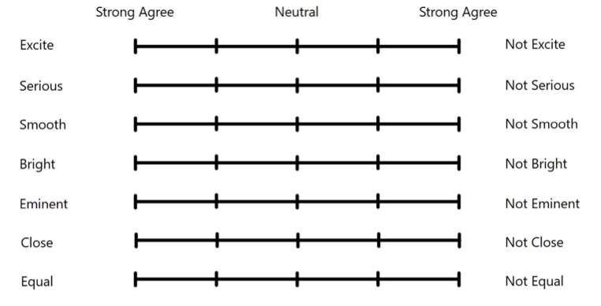
Second Experiment
Questionnaire: Dialogue Moods Questionnaire, Six emotions questionnaire
Despite two people being in the same conversational setting,
there may be opposite results in evaluating the dialogue atmosphere by both parties.
->For example:
one person may feel that the dialogue atmosphere is very Excite,
while another person may feel not
Notes:
This is the Dialogue Moods Questionnaire,beside this ,collaborators also need to answer the Six emotions questionnaire
We find Despite two people being in the same conversational setting,
there may be opposite results in evaluating the dialogue atmosphere by both parties.
For example:
one person may feel that the atmosphere is very Excite, while another person may feel not

Slide 10
Second Experiment
Cross-Validation Dialogue Mood Classification Result：
After normalization, PCA, one-hot encoding,
we trained SVM, Naive Bayes and KNN for dialogue mood.
 | SVM | Naive Baiyes | KNN
Excite | 0.730±0.12 | 0.672±0.12 | 0.656±0.12
Serious | 0.708±0.12 | 0.762±0.09 | 0.729±0.09
Smooth | 0.796±0.15 | 0.775±0.18 | 0.789±0.18
Bright | 0.712±0.15 | 0.726±0.18 | 0.683±0.18
Eminent | 0.694±0.18 | 0.677±0.18 | 0.622±0.16
Close | 0.688±0.12 | 0.689±0.16 | 0.638±0.22
Equal | 0.667±0.12 | 0.687±0.18 | 0.621±0.22
Smooth has better results,
while Eminent, Close and Equal have relatively poor classification results
Notes:
The Dialogue Mood cross-validation Classification Result
shows ECG and audio features can be used to classify Dialogue Mood
We find Smooth has better results
while Eminent, Close and Equal have relatively poor classification results

Slide 11
Second Experiment
Cross-validation Emotion Classification Result：
After normalization, PCA, one-hot encoding,
we trained SVM, Naive Bayes and KNN for emotion classification
 | SVM | Naive Baiyes | KNN
Relax | 0.684±0.12 | 0.648±0.22 | 0.614±0.16
Sadness | 0.694±0.12 | 0.675±0.18 | 0.576±0.26
Excited | 0.667±0.09 | 0.632±0.18 | 0.532±0.09
Fear | 0.714±0.22 | 0.739±0.25 | 0.634±0.18
Disgust | 0.578±0.25 | 0.643±0.25 | 0.611±0.22
Joy | 0.624±0.14 | 0.591±0.18 | 0.639±0.14
Due to insufficient samples, the classification results of Fear and Disgust have large fluctuations.
Notes:
We also did Emotion Classification
Due to insufficient samples, the classification results of Fear and Disgust have relatively large fluctuations.

Slide 12
Conclusions
Our Work:
This study uses machine learning algorithms like SVM, KNN, and Naive Bayes
to classify basic emotion and dialogue atmosphere in VR.
This study will be published in NCSP22
limitation of this study:
Individual differences appear in biological information,
which may relate to the surrounding environment and individual physique.
Lack of diversity sample(ex.Equal,Close,Fear Disgust)
Poor Contact problem of Muse2 while wearing VR headset
Notes:
Conclusions
This study uses machine learning algorithms to classify basic emotion and dialogue atmosphere in VR.
This study will be published in NCSP22
limitations of this study:
First, individual differences appear in biological information,
which may relate to the surrounding environment and individual physique.
Lack of diversity sample in some cases
The third limitation is Poor Contact problem of Muse2

Slide 13
Conclusions
Futrue Work:
Increase the amount of experimental data, and try Deep Learning
Apply real-time atmosphere and emotion recognition AI to ubiquitous VR innovative spaces and VR virtual humans
Propose a well-generalizing model that can continuously optimize by extracting personal features(reinforcement learning)
In the next stage, we tend to recognize the degree of confidence, interest, and psychological fluctuations in multi-person conversations or collaborations in VR.
Notes:
For Futrue Work recommendation:
i think we can
increase the amount of experimental data, and try Deep Learning
Apply real-time atmosphere and emotion recognition AI to ubiquitous VR innovative spaces and VR virtual humans
and we can propose a well-generalizing model that can continuously optimize by extracting personal features(reinforcement learning)
In the next stage, we tend to recognize the degree of confidence, interest, and psychological fluctuations in multi-person conversations or collaborations in VR environment.

Slide 14
Reference
[1] Yuhei Ikeda, Ryota Horie, and Midori Sugaya. Estimat_x0002_ing emotion with biological information for robot interac_x0002_tion. Procedia computer science, 112:1589–1600, 2017.
[2] Andrius Dzedzickis, Arturas Kaklauskas, and Vytautas Bucinskas. Human emotion recognition: Review of sen_x0002_sors and methods. Sensors, 20(3):592, 2020.
[3] Javier Mar´ın-Morales, Juan Luis Higuera-Trujillo,Alberto Greco, Jaime Guixeres, Carmen Llinares,Enzo Pasquale Scilingo, Mariano Alcaniz, and Gaetano Valenza. Affective computing in virtual reality: emo_x0002_tion recognition from brain and heartbeat dynamics using wearable sensors. Scientific reports, 8(1):1–15, 2018.
[4] NS Suhaimi, J Teo, and J Mountstephens. Emotional state classification in virtual reality using wearable elec_x0002_troencephalography. In IOP Conference Series: Materi_x0002_als Science and Engineering, volume 341, page 012016.IOP Publishing, 2018.
[5] Daisuke Katagami. Could we artificially create atmo_x0002_sphere? In The 27th Annual Conference of the Japanese Society for Artificial Intelligence(2013), page 2 pages. The Japanese Society for Artificial Intelligence, 2013.
Notes:
this is my references

Slide 15
Reference
[6] Kaoru Toyoda, Yoshihiro Miyakoshi, Ryosuke Yamanishi, and Shohei Kato. Dialogue mood estimation focus_x0002_ing on intervals of utterance state. Transactions of the Japanese Society for Artificial Intelligence, 27(2), 2012.
[7] Tatsuya Hasegawa and Shohei Kato. Dialogue mood estimation from speech sounds clusterized with speak_x0002_ers’ personality traits. In 2019 IEEE 8th Global Confer_x0002_ence on Consumer Electronics (GCCE), pages 399–401.IEEE, 2019.
[8] Margaret M Bradley and Peter J Lang. Measuring emo_x0002_tion: the self-assessment manikin and the semantic dif_x0002_ferential. Journal of behavior therapy and experimental psychiatry, 25(1):49–59, 1994.
[9] Theodoros Giannakopoulos. pyaudioanalysis: An open_x0002_source python library for audio signal analysis. PloS one,10(12):e0144610, 2015.

Slide 16
Acknowledgment
Thank you for listening
ご清聴ありがとうございます
Notes:
Thank u for listening,

